Slide 1
Machine Learning for Early Warning and Forecasting of Earthquakes
Fatih Bulut
2024 - İstanbul

Slide 2
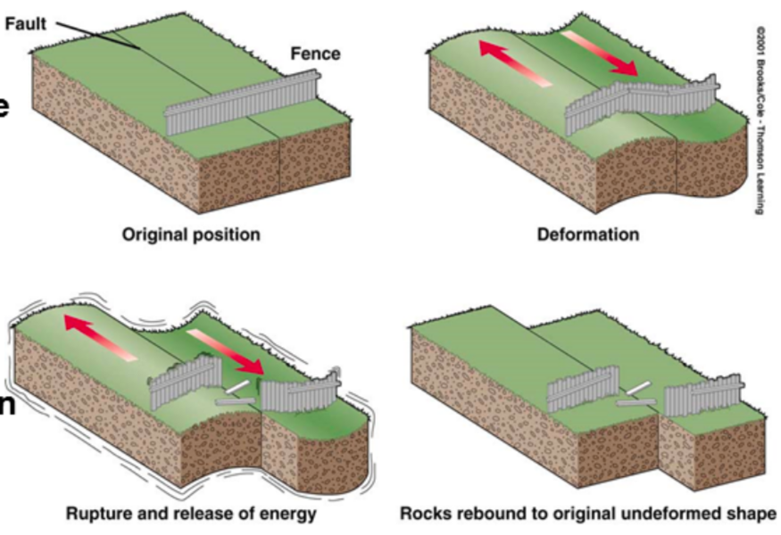
Earthquake Generation Process
Elastic Rebound Theory (Reid, 1910)

Slide 3
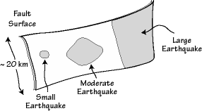
Earthquake Generation Process

Slide 4
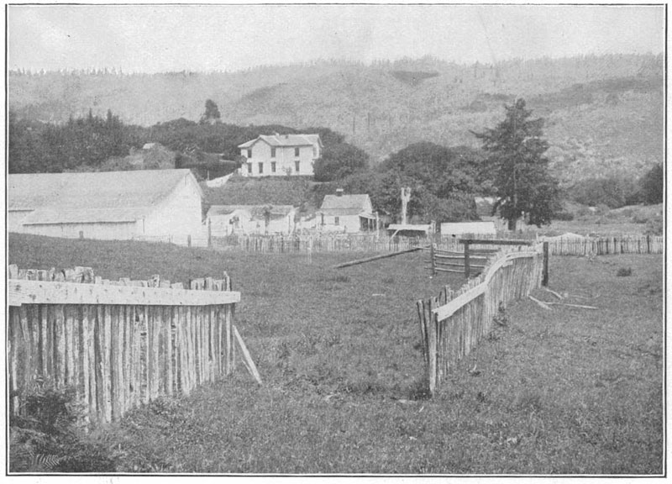
1906 San Francisco Earthquake (M 7.9)
Fault
by Gilbert (1908)

Slide 5
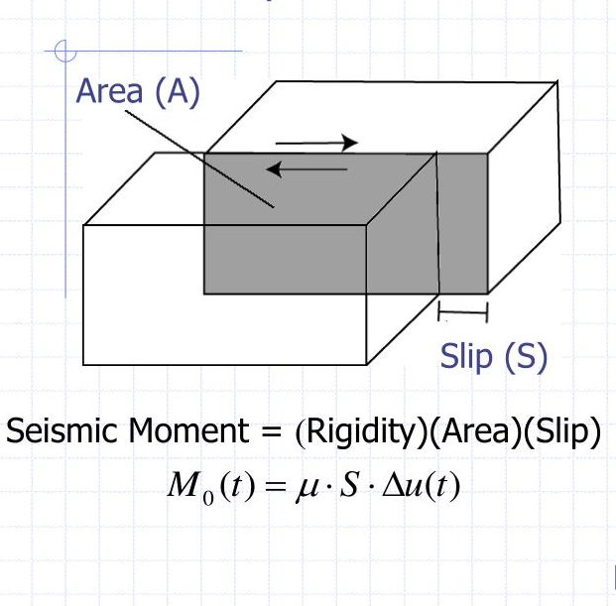
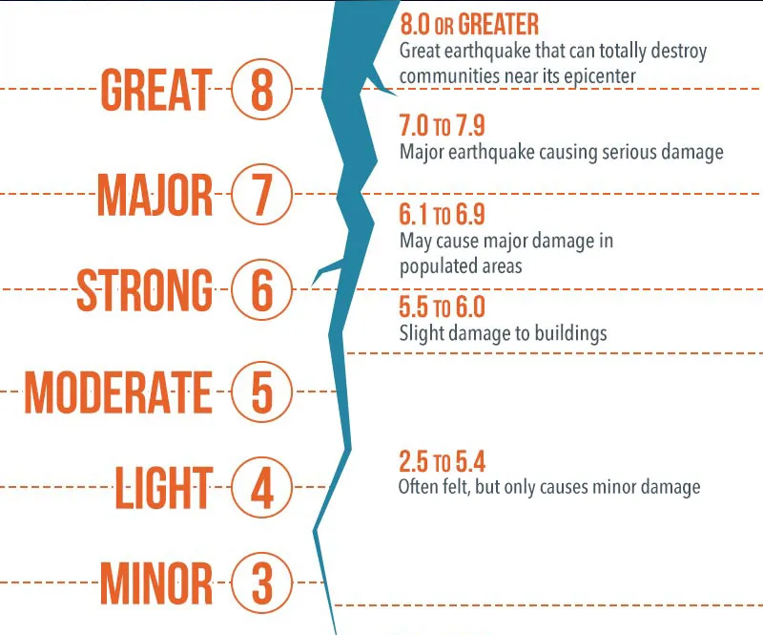
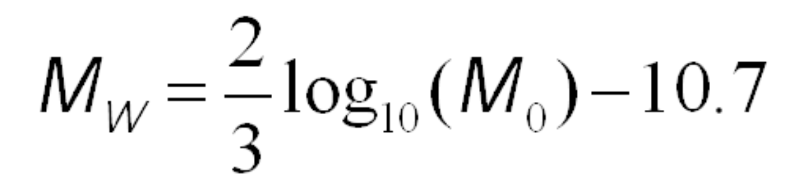
Earthquake Magnitude

Slide 6
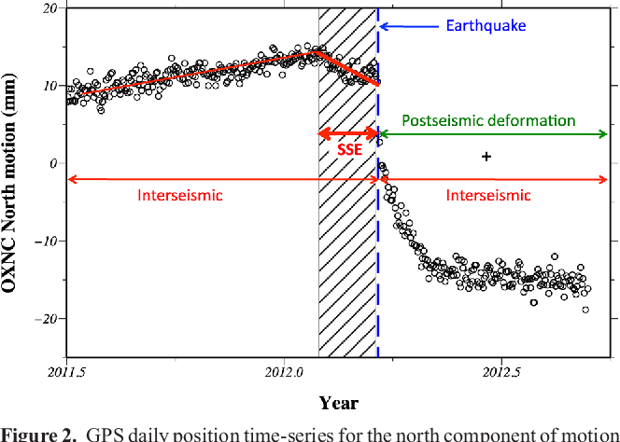
Earthquake Displacements
Elastic Rebound Theory (Reid, 1910)

Slide 7
Analysis of GPS time series
Investigate
Pre-, co– and post-earthquake motion of the Earth’s surface
- Scaling relations between signals and earthquake magnitudes/distances
Data Access
http://geodesy.unr.edu/NGLStationPages/gpsnetmap/GPSNetMap.html
Data Analysis
Inter-seismic trends
Pre-seismic wiggles
Co-seismic jumps
Post-seismic envelops

Slide 8
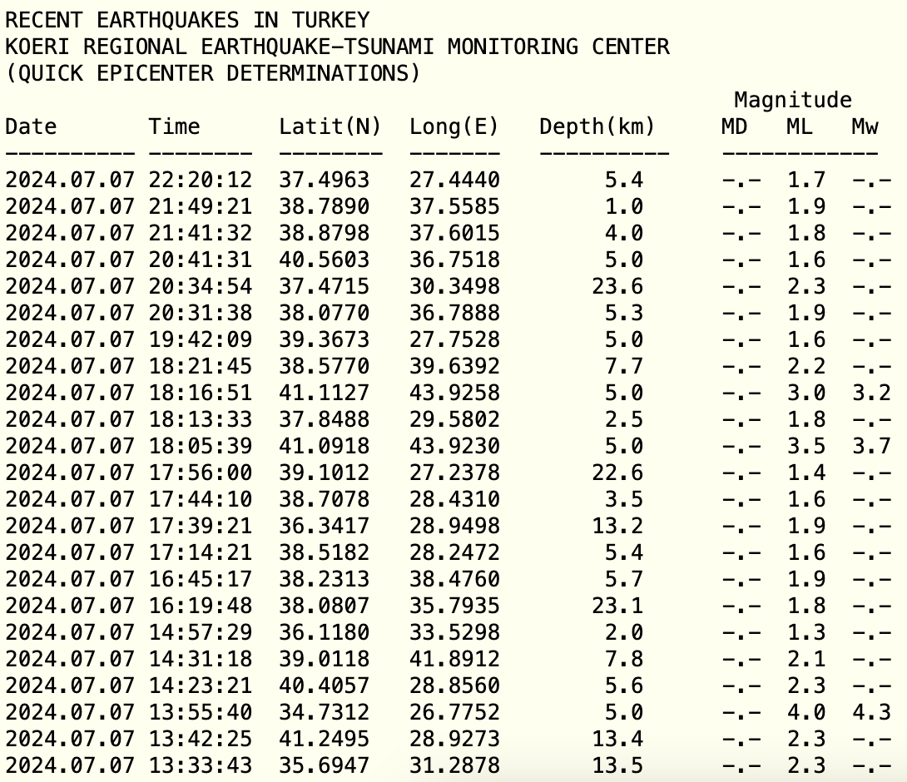
Earthquake Catalog

Slide 9
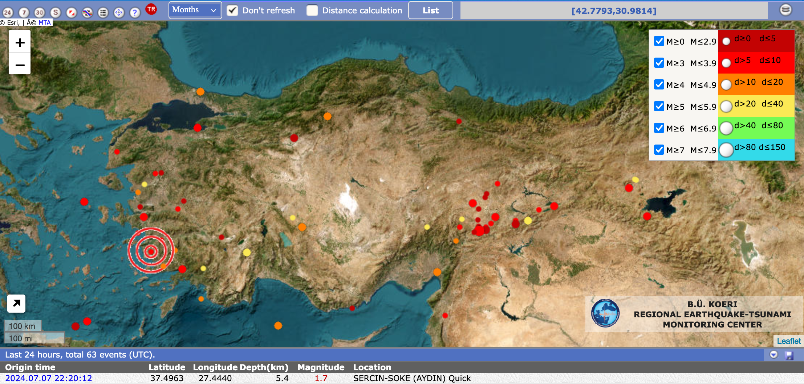
Earthquake Catalog

Slide 10
Analysis of Earthquake Catalogues
Investigate
Spatial and temporal patterns
Pre-earthquake behavior of background seismicity
Proximity to the mainshock hypocenter
Cycling for different magnitude ranges
Any other systematics among the catalog columns
Data Access
http://www.koeri.boun.edu.tr/sismo/zeqdb/ (Turkiye 1900 - now)
https://deprem.afad.gov.tr/event-instrumental (Turkiye 1900 - now)
https://deprem.afad.gov.tr/event-historical (Turkiye 2000BC-1900)
http://www.isc.ac.uk/iscgem/request_catalogue.php (Earth 1904 – 2020)

Slide 11
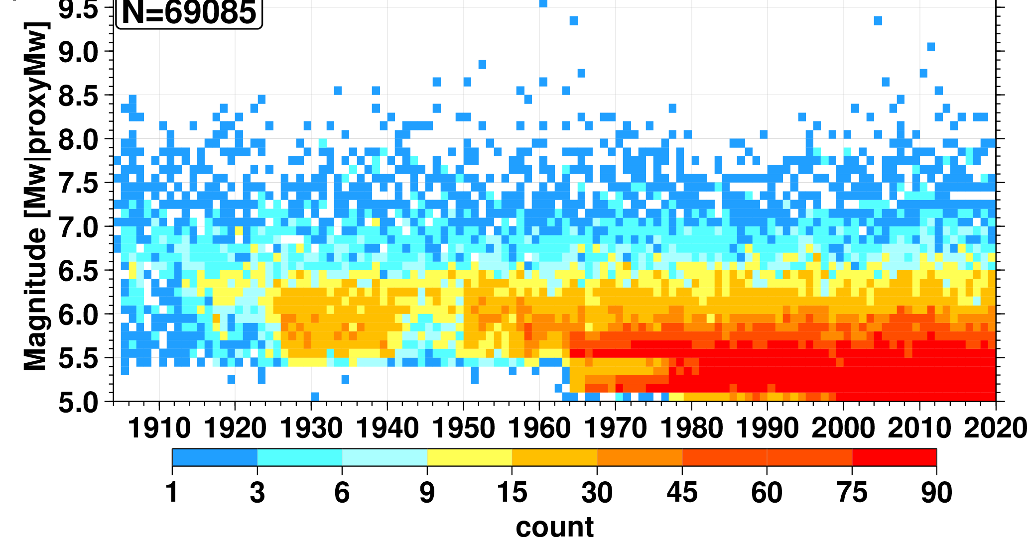
Analysis of Earthquake Catalogues
Data Preparation
Analyze in time and space below which magnitude the catalog is complete
Eliminate the data below completeness

Slide 12
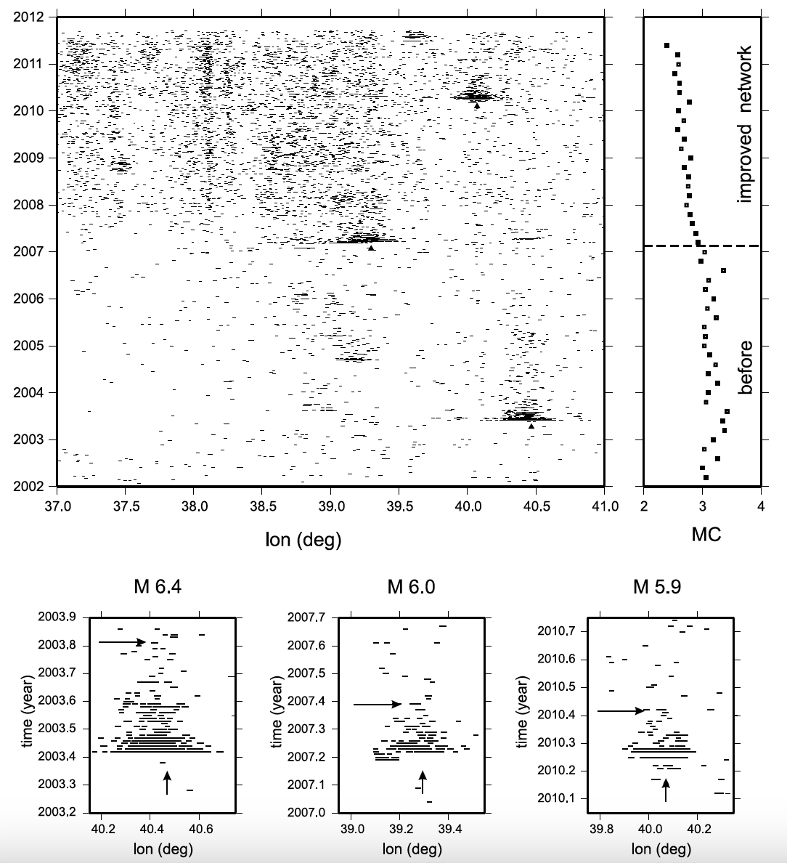
Analysis of Earthquake Catalogues
Data Analysis
Spatial and temporal patterns of magnitudes and locations of relatively small earthquakes in the vicinity of the hypocenter of large earthquakes

Slide 13
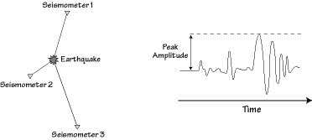
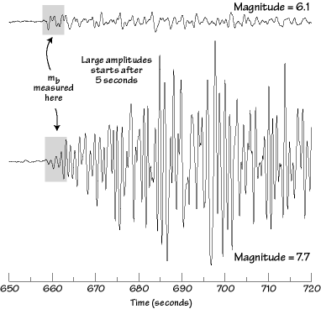
Earthquake Waveforms

Slide 14
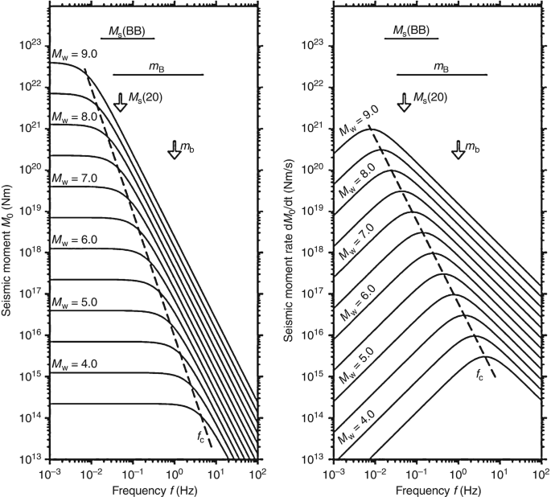
Earthquake Magnitude vs Waveform Content

Slide 15
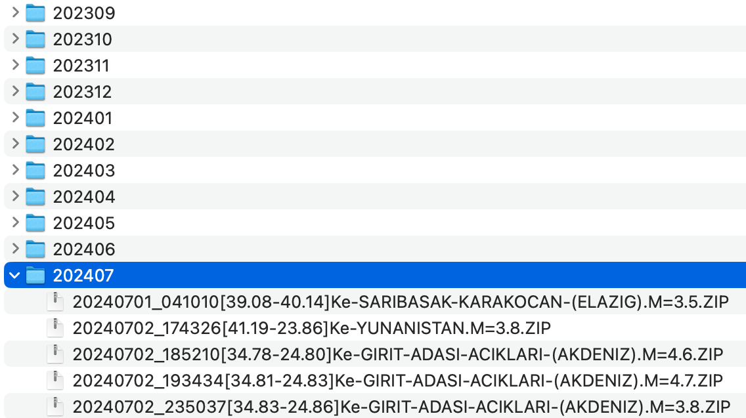
Rapid Magnitude Estimation
Investigate
Initial seconds of P-wave to estimate earthquake magnitude
Amplitude
Dominant Frequency
Magnitude-based weighting
Data Access
ftp//193.140.203.10
user: bdtim
pass: Fatin1868
https://tdvms.afad.gov.tr/

Slide 16
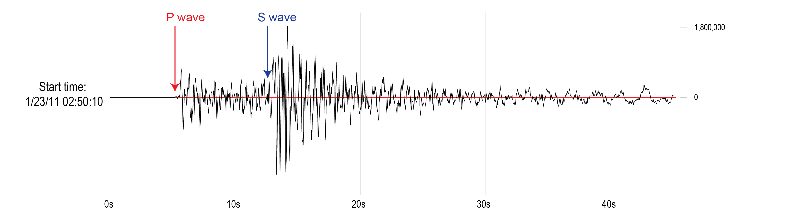
Rapid Magnitude Estimation
Data Format
.SAC
https://ds.iris.edu/files/sac-manual/manual/file_format.html
Data Preparation
Waveform Download
Pick first arrivals
Eliminate low SNR waveforms
Data Analysis
Dominant frequency and magnitudes
Maximum amplitude and magnitudes
Window length

Slide 17
% SACREAD Reads a sacfile into a sac structure
% Syntax sac = sacread('filename');
function sac = sacread(filename)
sac.filename = filename;
sacfile = fopen(sac.filename,'rb');
sac.fheader = fread(sacfile,70,'float32');
sac.iheader = fread(sacfile,40,'int32');
sac.aheader = ( char( fread(sacfile,192,'char') ) );
sac.data = fread(sacfile,'float32');
fclose(sacfile);

Slide 18
% Automatic picking of the P-wave onset
function [pick_sample] = aic(waveform)
% AIC picker
N = length(waveform);
aic = zeros(1, N);
for k = 2:N-1
var1 = var(waveform(1:k));
var2 = var(waveform(k+1:end));
aic(k) = k * log(var1) + (N - k - 1) * log(var2);
end
% Find the index of the minimum AIC value
[~, pick_sample] = min(aic(2:end-1));

